Slide 1
Chapter 8 Runtime Support

Slide 2
How program structures are implemented in a computer memory? The evolution of programming language design has led to the creation of increasingly sophisticated methods of runtime storage organization.
We will cover 3 methods:
1) static allocation,
2) stack allocation, and
3) heap allocation.

Slide 3
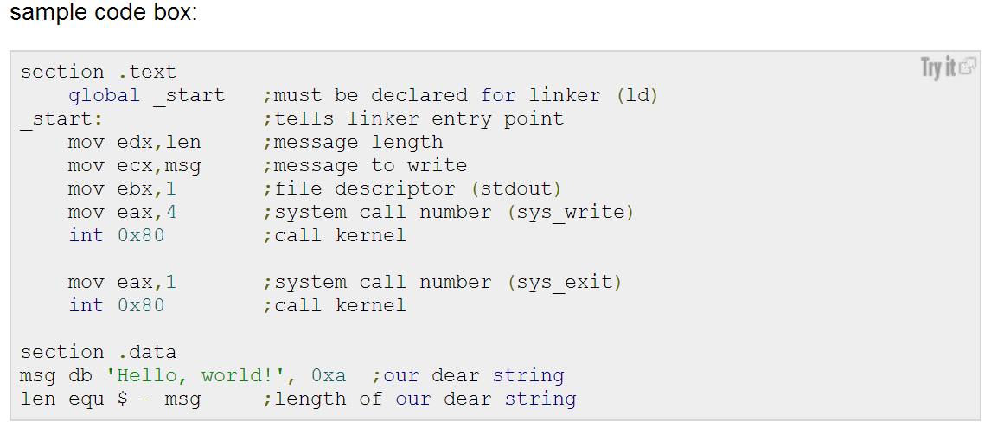
Sample Assembly Code

Slide 4
Static Allocation
Originally, all data were global. Correspondingly, all memory allocation was static.
During compilation, data was simply placed at a fixed memory address for the entire execution of a program. This is called static allocation.
Examples are all assembly languages, Cobol, and Fortran.

Slide 5
Static Allocation (Cont.)
Static allocation can be quite wasteful of memory space. To reduce storage needs, in Fortran, the equivalent statement overlays variables by forcing two variables to share the same memory locations. In C,C++, union does this too.
Overlaying hurts program readability, as assignment to one variable changes the value of another.

Slide 6
Static Allocation (Cont.)
In more modern languages, static allocation is used for global variables and literals (constant) that are fixed in size and accessible throughout program execution.
It is also used for static and extern variables in C/C++ and for static fields in C# and Java classes.

Slide 7
static inside a function
void foo() {
static int x ;
}
what does that mean?
Should you use that in practice?

Slide 8
Stack Allocation
Recursive languages require dynamic memory allocation. Each time a recursive method is called, a new copy of local variables (frame) is pushed on a runtime stack. The number of allocations is unknown at compile-time.
A frame (or activation record) contains space for all of the local variables in the method. When the method returns, its frame is popped and the space reclaimed.
Thus, only the methods that are actually executing are allocated memory space in the runtime stack. This is called stack allocation.

Slide 9
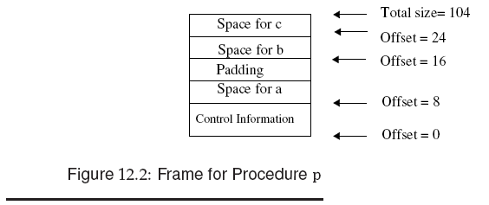
padding in the stack frame so that the total size is double-word aligned (i.e., a multiple of 2 words, or 8 bytes).

Slide 10
int fact (int n) {
if (n>1) return n* fact (n-1);
else return 1;
}
See the staxk allocation in Fig. 12.3 next.

Slide 11
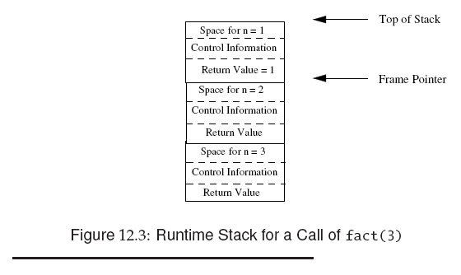
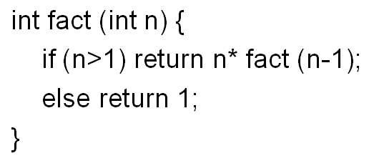
a frame pointer
is usually kept in
a register.
Remember EBP?

Slide 12
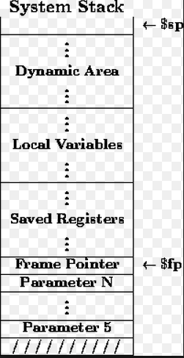
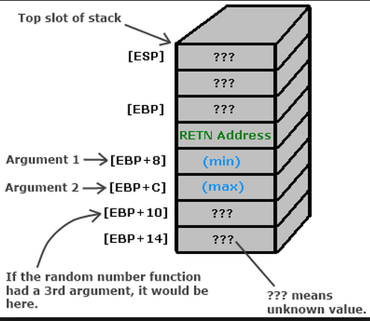

Slide 13
Because the stack may contain more than just frames (e.g., registers saved across calls), dynamic link is used to point to the preceding frame (Fig. 12.4).

Slide 14
So, when a function is returned, the frame pointer is
redirected to the frame of dynamic link

Slide 15
class k {
int a;
int sum () {
int b = 42;
return a+b;
}
}
When obj.sum() is called, local data “b” resides in a frame on the runtime stack. And, object member data “a” is accessed through an object pointer called “this”. (see Fig. 12.5)

Slide 17
Some programming languages (e.g., Pascal and Ada) support nested subroutines, allowing an inner routine to access the context of its outer enclosing routine, i.e., the parameters and local variables within the scope of the outer routine. Such static nesting can repeat - a function declared within a function declared within a function..
int p (int a) {
int q (int b) { if (b <0) q (-b) else return a+b; }
return q (-10);
}
Methods can nest in C, Java as above. A static link points to the frame of the method that statically encloses the current method. (Fig. 12.6)

Slide 18
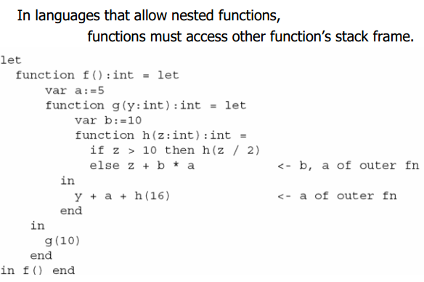
Variable Scope of nested function
int p (int a) {
int x ;
int q (int b) { if (b <0) q (-b) else return a+b; }
return q (-10);
}
So, q() is able to access x if you want to
more examples

Slide 19
An alternative to using static links to access frames of enclosing methods is the use of a display. Here, we maintain a set of registers which comprise the display. (see Fig. 12,7)

Slide 20
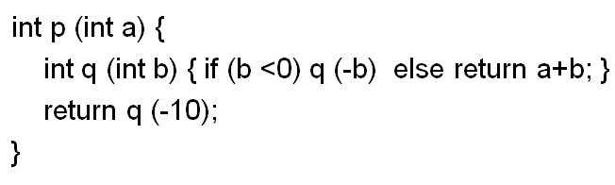
the references to the enclosing static frames may be collected into an array of pointers known as a display which is indexed to locate a desired frame.

Slide 21
void p (int a) {
int b;
if (a>0) {float c,d; //body of block 1//}
else {int e[10]; //body of block 2//}
}
Because the then and else parts of the if statement above are mutually exclusive, variables in block 1 and block 2 can overlay each other. This is called procedure-level frame, as contrasted with block-level frame allocation. (Fig. 12.8)

Slide 22
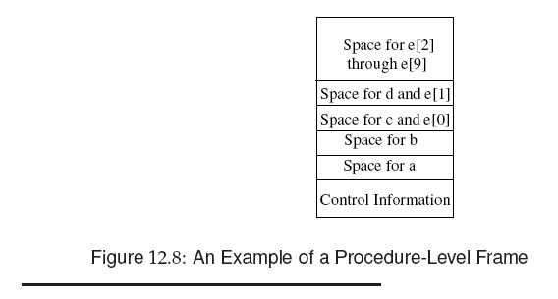
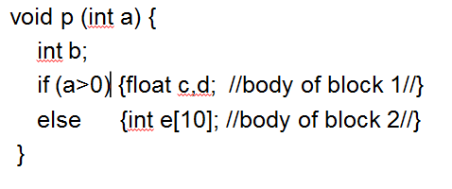

Slide 23
Sample Code Generation for stack frame operation?
main() {
push b; // yes, b is pushed first because C is
push a ; // right to left.
call foo ;
mov w, [EBP + offset of return value]
mov EBP, dynamic link
…..
}
foo:
mov dynamic link, EBP // save the stack frame of main()
mov EBP, ESP // set the EBP (frame pointer) to the new stack frame
add ESP, size of stack frame // determined at compilation time.
mov EAX, [EBP+ offset of min ]
mov [EBP+offset of z], EAX
mov [EBP+ offset of return value], EAX
mov ESP, EBP ; // reset stack top to return address
ret ;
}
main() {
w = foo(a,b);
}
int foo (int min, int max) {
int z ;
z = min;
return z;
}

Slide 24
Heap Allocation
Lisp and subsequent C, C++, C#, and Java used a scheme to dynamically allocate data, called heap allocation.
Heap allocation allows memory blocks to be allocated (by a call to “new” or “malloc”) and freed (by a call to “free”) at any time and in any order during program execution.
Thus, each program execution can “customize” its memory allocation needs.

Slide 25
Memory Management
When a program is started, most operating systems allocate 3 memory segments for it:
1) code segment: read-only
2) stack segment (data):
manipulated by machine instructions.
3) heap segment (data):
manipulated by the programmer.

Slide 26
Memory Management
Allocating memory in heap:
1. keep a pointer to the first free location in the heap.
2. allocate the required block from there.
3. bump the pointer to the next free location.
The problem with this scheme is that sooner or later, we run out of heap space.
Thus, we need to release the blocks.

Slide 27
Memory Management
Two data de-allocation schemes:
1) explicit de-allocation
by the programmer at compile-time,
2) implicit de-allocation
by operation system at run-time.

Slide 28
Basic memory allocation
A memory allocation program
1) finds a block of unused memory of the requested size,
2) marks it as used, and
3) returns a pointer to the block.
If no such block is available, the result varies:
1) a null pointer may be returned,
2) an error routine may be called, or
3) the program may be aborted.

Slide 29
Block vs. Chunk
Blocks are handled by programmer, and
Chunks are handled by the memory
allocation program.
A chunk contains a block plus some administration information, which includes the length of the chunk and is usually located just before the block.

Slide 30
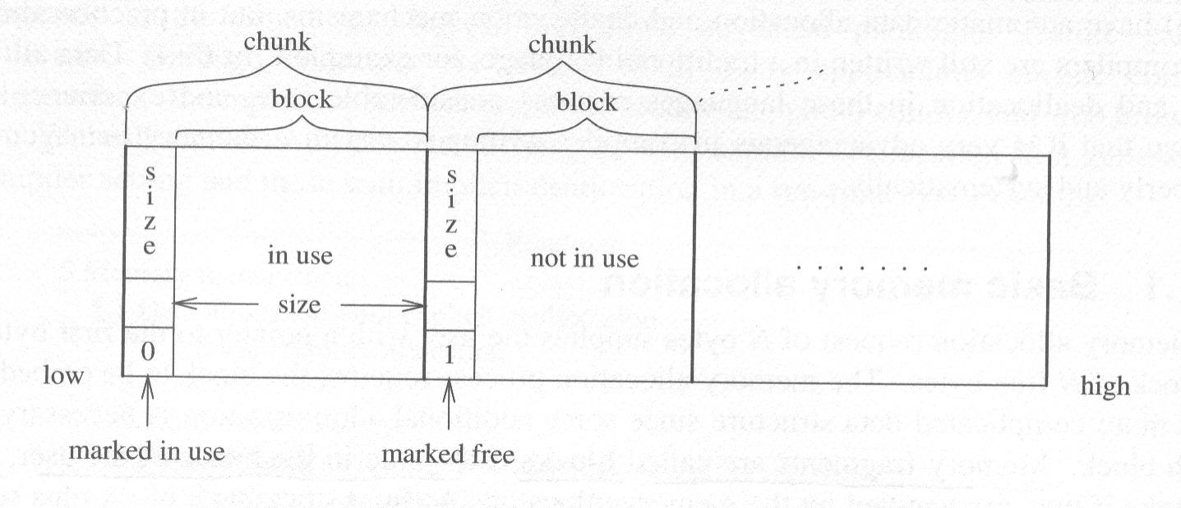
Block vs. Chunk (Cont.)

Slide 31
Block vs. Chunk (Cont.)
We need a few bits in each chunk for administration purposes:
One of the bits is a free bit, which indicates whether a chunk is free or not.
And, the free chunks form the free list.

Slide 32
Basic memory allocation
The basic memory allocation includes “malloc()” (for memory allocation) and
“free()” to de-allocate memory.
De-allocation is explicitly indicated by the programmer.
Explicit de-allocation is a problem for programmer and compiler as well.

Slide 33
Basic memory allocation
Programmer uses “free()” to de-alloctae. But, it is hard to predict lifetime of data.
Many programmers free memory too early by mistake and, later on, dereferencing a ‘dangling pointer’ to the freed – and possibly re-allocated – data.

Slide 34
Basic memory allocation
This error is hard to find because:
The dangling pointer is de-referenced long after the “free”
After dereferencing, the program can still proceed without being detected
Interactive system prohibits reproduce exact sequence of memory allocation and de-allocation that are required for debugging.
Therefore, implicit de-allocation (automatic garbage collection) next is preferred.

Slide 35
Implicit de-allocation
Implicit de-allocation,
called garbage collection ,
is the automatic reclamation of memory
that is no longer in use
by the application program.

Slide 36
Garbage collection algorithm
The garbage collection is to reclaim automatically the set of memory chunks that will no longer be used by the program (garbage):
1) Chunks to which there are no pointers, and
2) Chunks that are not reachable
from the non-heap-allocated program data.

Slide 37
Garbage collection algorithm
1) ‘No-pointers’ above leads to a technique called reference counting.
It directly identifies garbage chunks.
It is simple and reasonably efficient,
but requires all pointer actions to be monitored during program execution
and may not recover all garbage chunks.

Slide 38
Reference Counting
Reference counting records in each chunk
the number of pointers
that point to it;
when the number drops to zero,
the chunk is declared “garbage”.

Slide 39
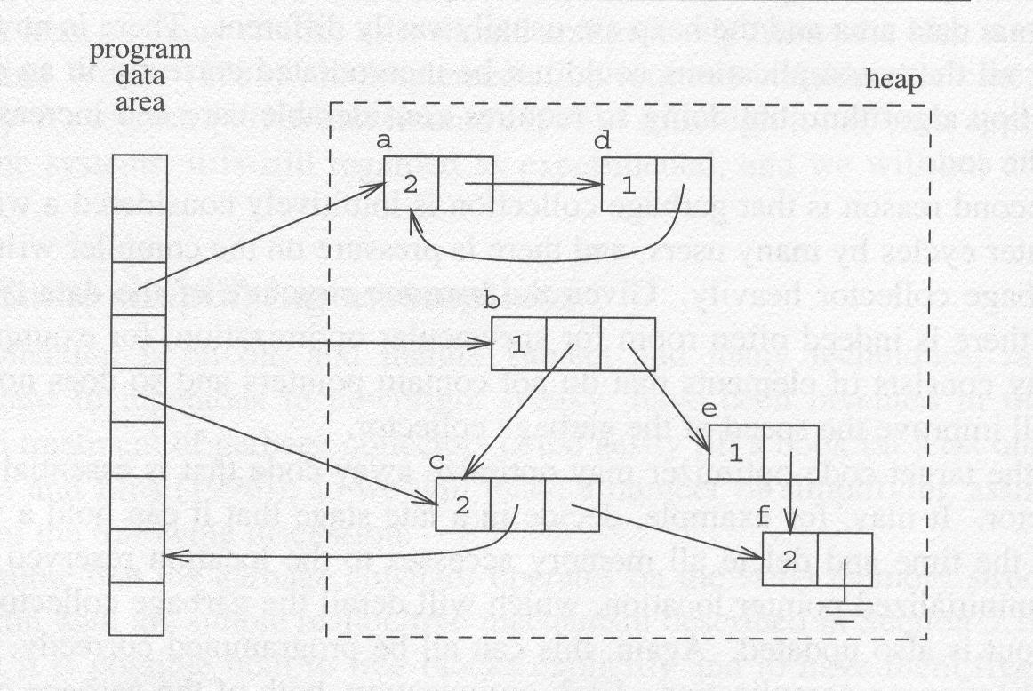
Reference Counting
Chunks with reference count in a heap

Slide 40
Circularity in Reference Counting
In Fig. 12.15 next, the two objects point to each other forming a circular structure.
If the global pointer p is set to null, the object’s reference count is reduced from 2 to 1. Now, both objects have a non-zero count (thus will NOT be de-allocated), but neither is accessible through any external pointer.

Slide 42
Mark-Sweep Garbage Collection
Marking phase:
1) Starting with global pointers and pointers in stack frames, we mark reachable heap objects (perhaps setting a bit in the object’s header).
2) Then, follow the pointers in the marked objects until all live objects are marked.

Slide 43
Mark-Sweep Garbage Collection (Cont.)
Sweep phase:
After marking phase, any object not marked is regarded as garbage that may be freed.
We then “sweep” through the heap, collecting all unmarked objects and returning them to the free space list for later reuse.
Compaction phase:
We can add a compaction phase as shown in Fig. 12.17.

Slide 45
The mark-sweep scheme has a problem that all heap objects must be swept. This can be costly if most objects are dead.
On the other hand, copying collector examines ONLY live objects.

Slide 46
Copying Collectors
We divide the heap into two halves:
1) the from space
2) the to space.
We allocate objects in the from space. When it is exhausted, we collect live objects and copy them to the to space.

Slide 48
